Slide 1


Data warehouse SCHEMA
Kuliah Manajemen Data / Manajemen Database
Dr. Achmad Solichin | Universitas Budi Luhur
Magister Ilmu Komputer & Magister Manajemen
Universitas Budi Luhur

Slide 2
Transactional vs Informational
Transaksional
Untuk otomasi proses bisnis
Sasaran: efisiensi
Menentukan proses bisnis
Digerakkan oleh event transaksi
Optimasi proses transaksi
Informasional
Mendukung pengambilan keputusan
Sasaran: keefektifan
Disesuaikan dengan situasi bisnis
Mengantisipasi event transaksi
Optimasi query (pengambilan data)
VS

Slide 3
DW / MULTIDIMENSIONAL SCHEMA
Multidimensional Schema is especially designed to model data warehouse systems. The schemas are designed to address the unique needs of very large databases designed for the analytical purpose (OLAP).

Slide 4
DW / MULTIDIMENSIONAL SCHEMA
Typically warehouse data is multidimensional, with very large fact tables
Examples of dimensions: item-id, date/time of sale, store where sale was made, customer identifier
Examples of measures: number of items sold, price of items
Dimension values are usually encoded using small integers and mapped to full values via dimension tables
Resultant schema is called a star schema
More complicated schema structures: Snowflake schema, Constellation/Galaxy schema

Slide 5
3 TYPES of DW SCHEMA
Star Schema
Snowflake Schema
Galaxy Schema

Slide 6
STAR SCHEMA
Star Schema in data warehouse, in which the center of the star can have one fact table and a number of associated dimension tables. It is known as star schema as its structure resembles a star.
The Star Schema data model is the simplest type of Data Warehouse schema. It is also known as Star Join Schema and is optimized for querying large data sets.

Slide 7
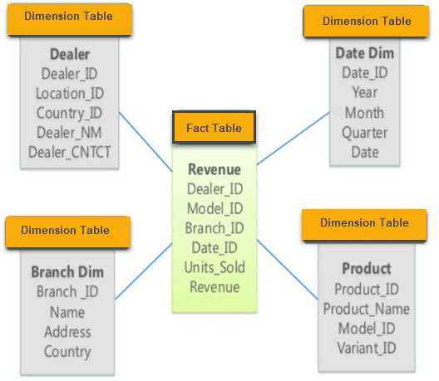
STAR SCHEMA: EXAMPLE 1

Slide 8
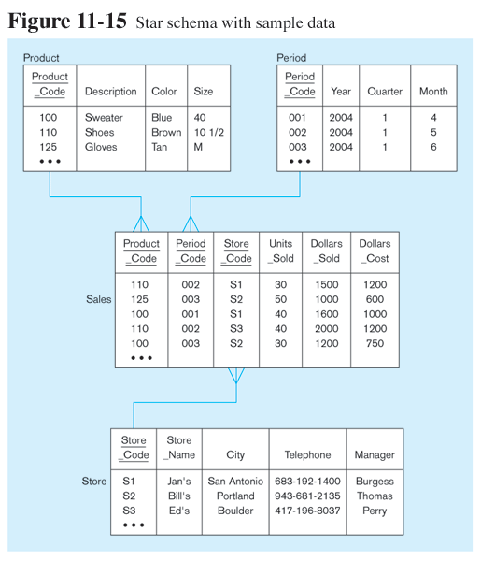
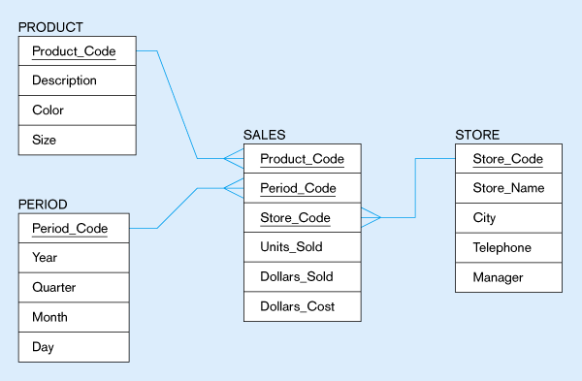
STAR SCHEMA: EXAMPLE 2
Fact table provides statistics for sales broken down by product, period and store dimensions

Slide 9
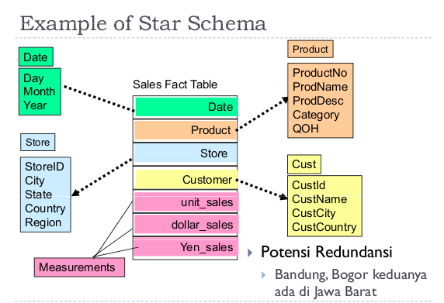
STAR SCHEMA: EXAMPLE 3

Slide 10
Characteristics of Star Schema
Every dimension in a star schema is represented with the only one-dimension table.
The dimension table should contain the set of attributes.
The dimension table is joined to the fact table using a foreign key
The dimension table are not joined to each other
Fact table would contain key and measure
The Star schema is easy to understand and provides optimal disk usage.
The dimension tables are not normalized.
The schema is widely supported by BI Tools

Slide 11
SNOWFLAKE SCHEMA
Snowflake Schema in data warehouse is a logical arrangement of tables in a multidimensional database such that the ER diagram resembles a snowflake shape.
A Snowflake Schema is an extension of a Star Schema, and it adds additional dimensions. The dimension tables are normalized which splits data into additional tables.

Slide 12
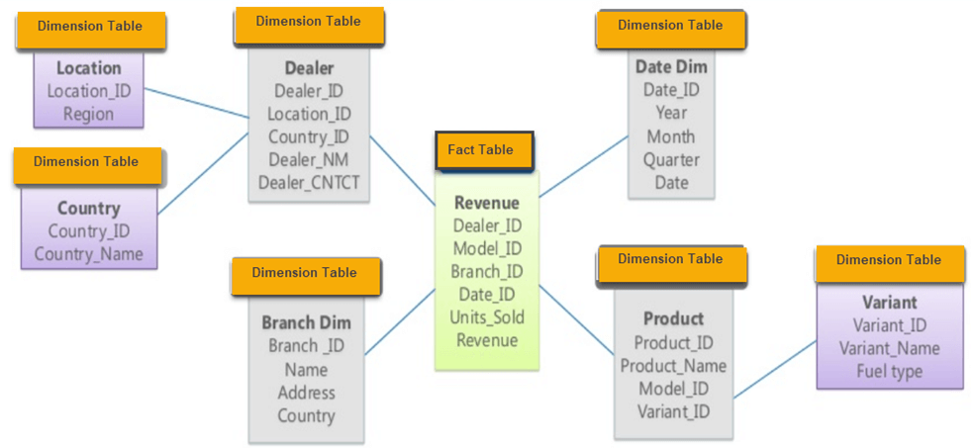
SNOWFLAKE SCHEMA: EXAMPLE 1

Slide 13
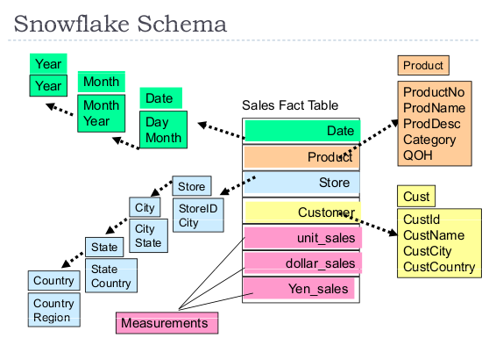
SNOWFLAKE SCHEMA: EXAMPLE 2

Slide 14
Characteristics of SNOWFLAKE Schema
The main benefit of the snowflake schema it uses smaller disk space.
Easier to implement a dimension is added to the Schema
Due to multiple tables query performance is reduced
The primary challenge that you will face while using the snowflake Schema is that you need to perform more maintenance efforts because of the more lookup tables.

Slide 15
Star Schema Vs Snowflake Schema
Star Schema | Snowflake Schema
Hierarchies for the dimensions are stored in the dimensional table. | Hierarchies are divided into separate tables.
It contains a fact table surrounded by dimension tables. | One fact table surrounded by dimension table which are in turn surrounded by dimension table
In a star schema, only single join creates the relationship between the fact table and any dimension tables. | A snowflake schema requires many joins to fetch the data.
Simple DB Design. | Very Complex DB Design.
Denormalized Data structure and query also run faster. | Normalized Data Structure.
High level of Data redundancy | Very low-level data redundancy
Single Dimension table contains aggregated data. | Data Split into different Dimension Tables.
Cube processing is faster. | Cube processing might be slow because of the complex join.
Offers higher performing queries using Star Join Query Optimization. Tables may be connected with multiple dimensions. | The Snowflake schema is represented by centralized fact table which unlikely connected with multiple dimensions.

Slide 16
GALAXY SCHEMA
A Galaxy Schema contains two fact table that share dimension tables between them.
It is also called Fact Constellation Schema.
The schema is viewed as a collection of stars hence the name Galaxy Schema.

Slide 17
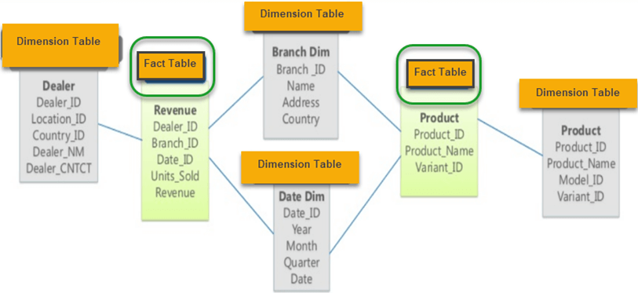
GALAXY SCHEMA: EXAMPLE

Slide 18
Characteristics of Galaxy Schema
The dimensions in this schema are separated into separate dimensions based on the various levels of hierarchy.
For example, if geography has four levels of hierarchy like region, country, state, and city then Galaxy schema should have four dimensions.
Moreover, it is possible to build this type of schema by splitting the one-star schema into more Star schemes.
The dimensions are large in this schema which is needed to build based on the levels of hierarchy.
This schema is helpful for aggregating fact tables for better understanding.

Slide 19
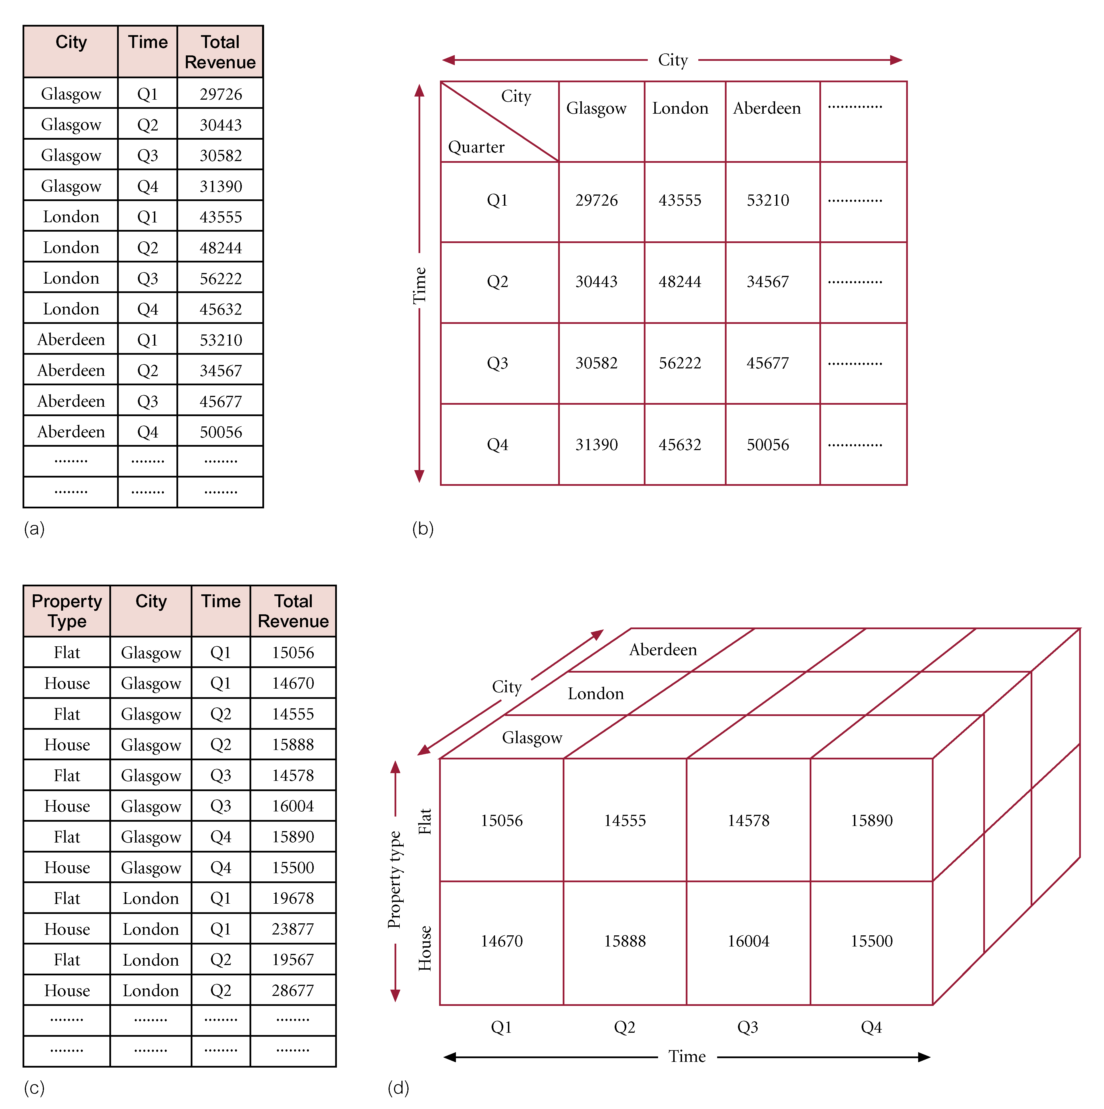
Representation of Multi-dimensional Data
Example of two-dimensional query.
What is the total revenue generated by property sales in each city, in each quarter of 2004?’
Choice of representation is based on types of queries end-user may ask.
Compare representation - 3-field relational table vs 2-dimensional matrix.

Slide 20
Representation of Multi-dimensional Data
Example of 3-dimensional query.
‘What is the total revenue generated by property sales for each type of property (Flat or House) in each city, in each quarter of 2004?’
Compare representation - four-field relational table versus three-dimensional cube.

Slide 21
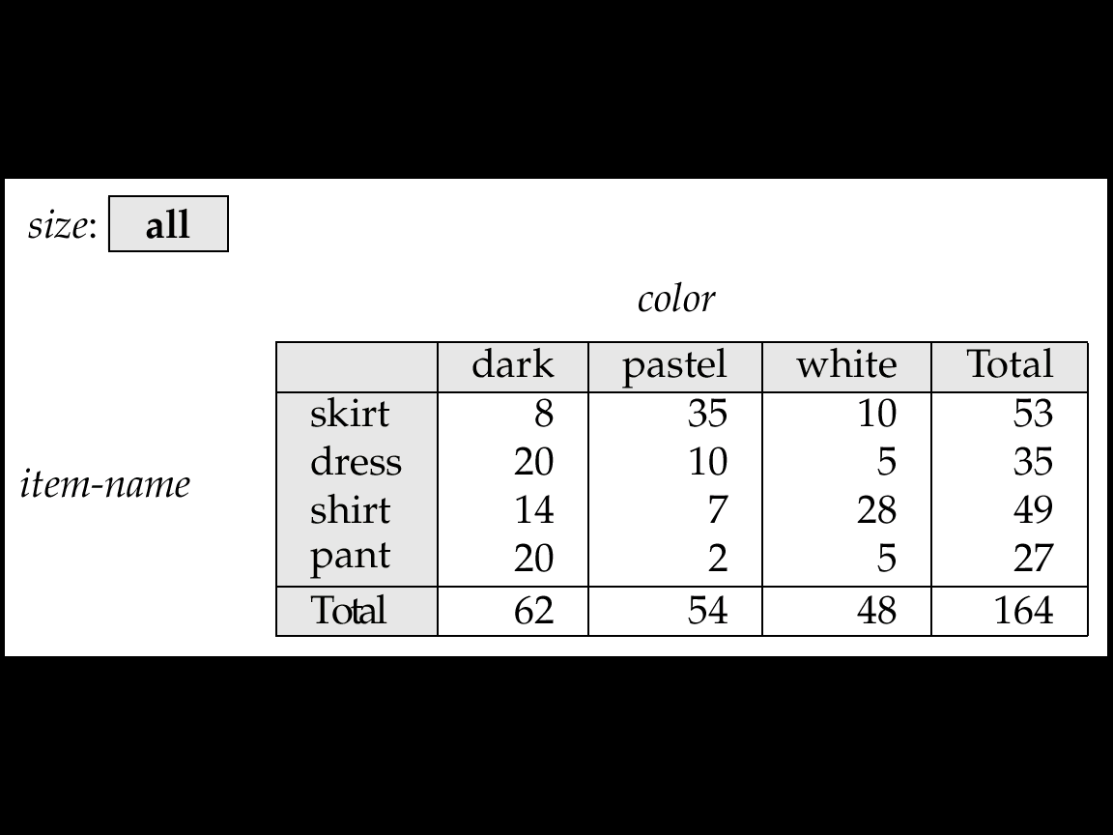
Cross Tabulation of sales by item-name and color
The table below is an example of a cross-tabulation (cross-tab), also referred to as a pivot-table.
A cross-tab is a table where
Values for one of the dimension attributes form the row headers, values for another dimension attribute form the column headers
Other dimension attributes are listed on top
Values in individual cells are (aggregates of) the values of the dimension attributes that specify the cell.

Slide 22
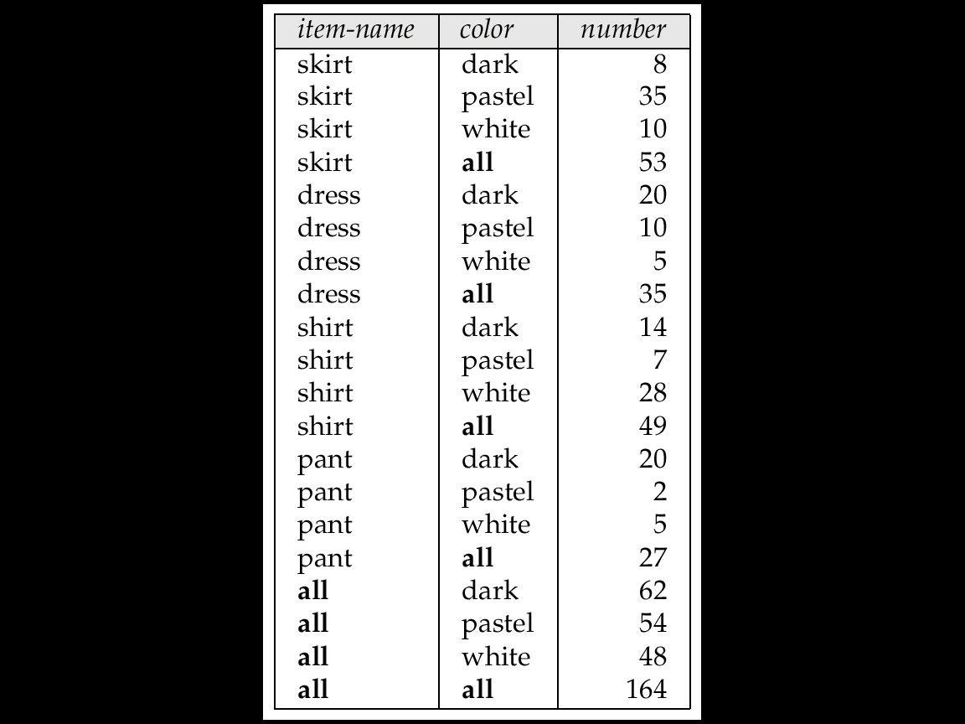
Relational Representation of Crosstabs
Crosstabs can be represented as relations
The value all is used to represent aggregates
The SQL:1999 standard actually uses null values in place of all

Slide 23
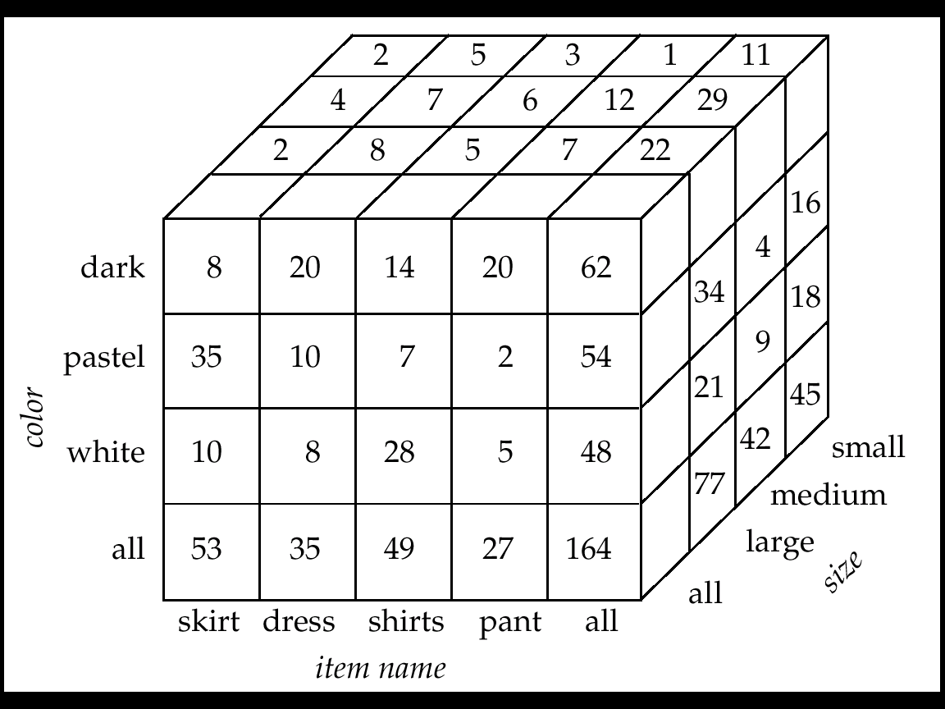
Three-Dimensional Data Cube
A data cube is a multidimensional generalization of a crosstab
Cannot view a three-dimensional object in its entirety, but crosstabs can be used as views on a data cube

Slide 24
DW OPERATIONS
The operation of changing the dimensions used in a cross-tab is called pivoting
Suppose an analyst wishes to see a cross-tab on item-name and color for a fixed value of size, for example, large, instead of the sum across all sizes.
Such an operation is referred to as slicing. The operation is sometimes called dicing, particularly when values for multiple dimensions are fixed.
The operation of moving from finer-granularity data to a coarser granularity is called a rollup.
The opposite operation - that of moving from coarser-granularity data to finer-granularity data – is called a drill down.

Slide 25
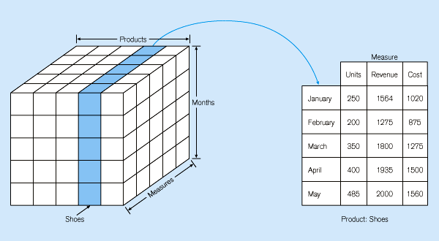
SLICING AND DICE

Slide 26
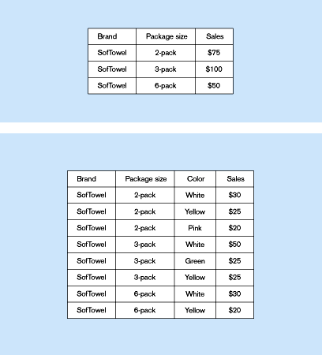
DRILL-DOWN
Summary report
Starting with summary data, users can obtain details for particular cells
Drill-down with color added
Notes:
Ke bawah drill-down, ke atas roll-up
26

Slide 27
ROLL-UP
Summary report
Performs aggregation on a data cube (dimension reduction)
Roll-up with color removed
Notes:
Ke bawah drill-down, ke atas roll-up
27

Slide 28
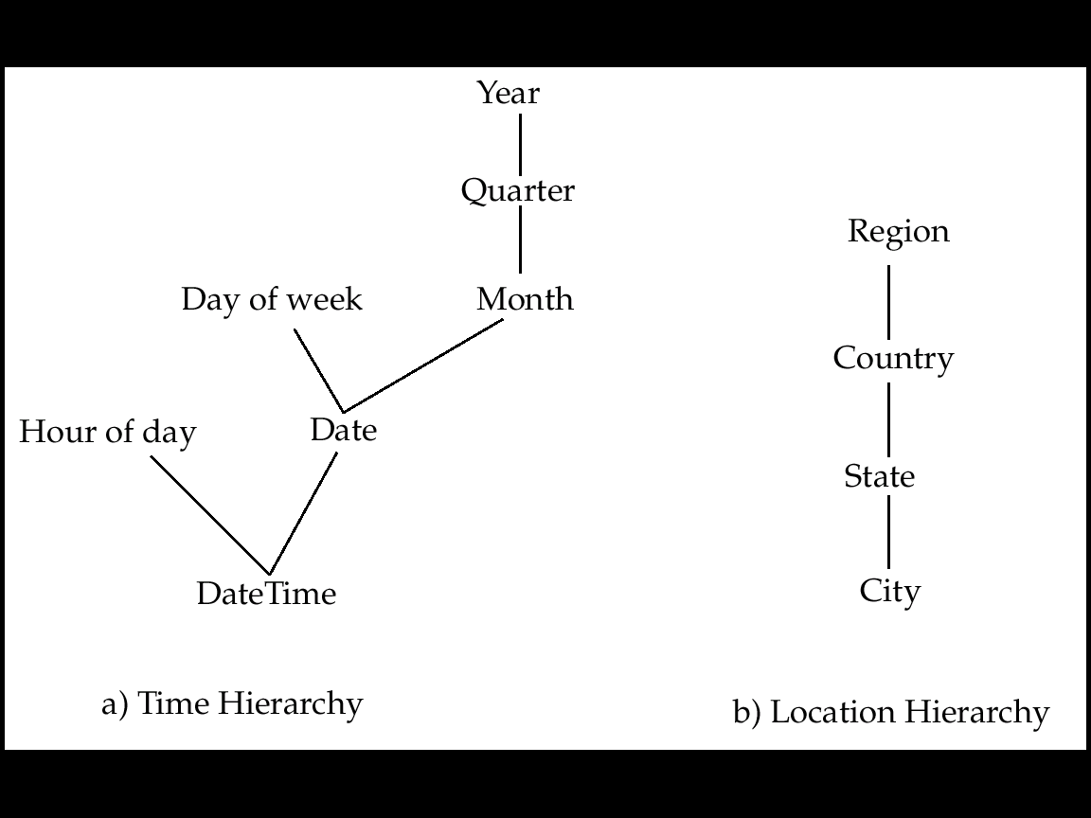
Hierarchies on Dimensions
Hierarchy on dimension attributes: lets dimensions to be viewed at different levels of detail
E.g. the dimension DateTime can be used to aggregate by hour of day, date, day of week, month, quarter or year

Slide 29
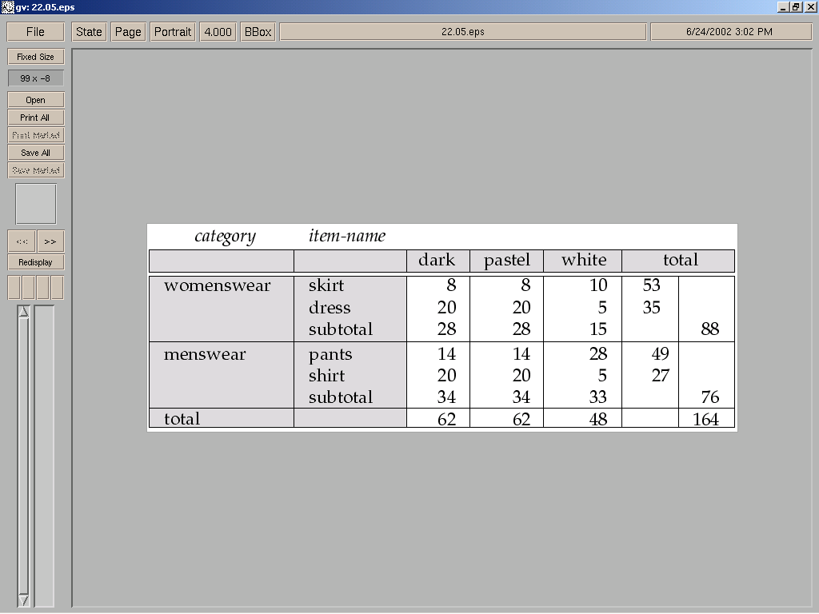
Cross Tabulation With Hierarchy
Crosstabs can be easily extended to deal with hierarchies
Can drill down or roll up on a hierarchy

Slide 30
REFERENSI
Buku “Data Mining: Concepts and Techniques”, Jiawei Han & Micheline Kamber. Morgan Kaufman Publishers
https://www.guru99.com/star-snowflake-data-warehousing.html
Slide “DW & OLAP” – YGS – Universitas Indonesia.

Slide 31
TERIMA KASIH

